Slide 1
Multi-hop Inference for
Question-driven Summarization
ADVISOR: JIA-LING, KOH
SOURCE: EMNLP ’20
SPEAKER: kuan-yu, sheng
DATE: 2021/01/18

Slide 2
Outline
Introduction
Method
Experiment
Conclusion

Slide 3
Introduction
3
Goal
Question
Summary
Document

Slide 4
Introduction
4
Question definition
Query-Based Summarization task :
Extractive approaches :
Advantage: No OOV Problem.
Disadvantage : Heavily rely on hand-crafted features
Abstractive approaches:
Advantage: More coherent and logical summaries to answer.
Disadvantage : OOV Problem.
Both problem : Typically based on semantic relevance measurement without a careful reasoning or inference process.

Slide 5
5
Introduction
5
Multi-hop Inference
1st – hop : Italic
2nd –hop : Underlined
3rd - hop :

Slide 6
Outline
Introduction
Method
Experiment
Conclusion

Slide 7
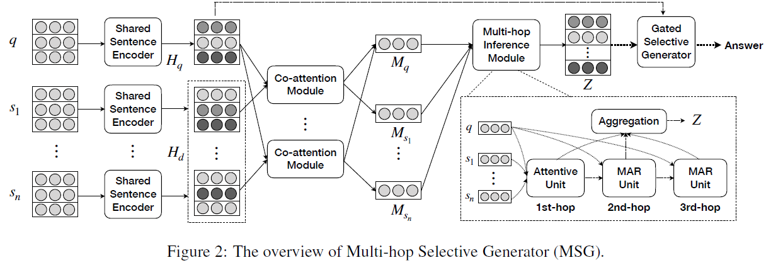
Method
Model overview – Multi-hop Selective Generator
Notes:
A1再圖4有
A1 = 3
A2 = 24

Slide 8
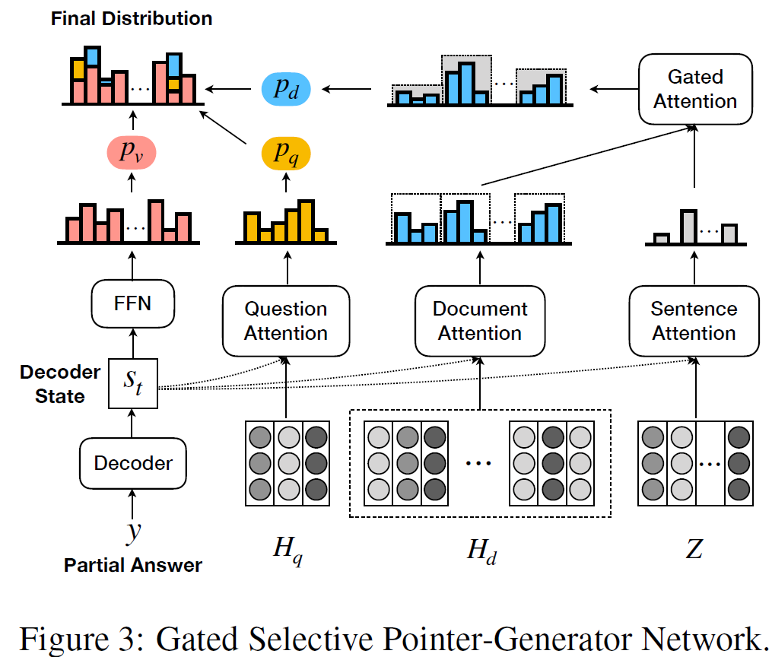
Method
Model overview – Gated Selective Generator
Notes:
A1再圖4有
A1 = 3
A2 = 24

Slide 9
Method
Co-attentive Encoder
Input encoding :
Document = $S_{1}$ , $S_{2}$ , $S_{3}$ … $S_{n}$ .
Question = $S_{q}$ .
$S_{i}$
l denotes the sentence length
d denotes the word embedding dimension.
Use Bi-LSTM share encoder learn contextual information.
Document = .
Question = $H_{sq}$ .
$$H_{s1}$$
$$H_{s2}$$
$$H_{n}$$
$$S_{0}$$
Bi-LSTM
Bi-LSTM
Bi-LSTM
$$S_{1}$$
$$S_{2}$$
$$S_{n−1}$$
Notes:
A1再圖4有
A1 = 3
A2 = 24

Slide 10
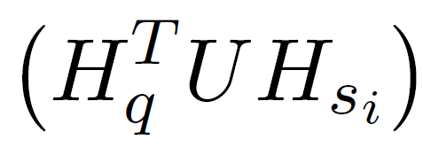
Method
Co-attentive Encoder
Co-attention :
$d_{n}$* $d_{n}$
= l * l
$$Q_{w1}$$
$Q_{w2}$ …..
$$Q_{wl}$$
$$S_{i1}$$
$$S_{i2}$$
$$S_{il}$$
…..
$d_{n}$* l
l * $d_{n}$
$$S_{i1}$$
$$Q_{w1}$$
$$S_{i2}$$
$$Q_{w2}$$
MAX
MAX
MAX
MAX
MAX
MAX
…..
…..
$$Q_{wl}$$
$$S_{il}$$
Words in $i^{th}$ Sentence
reweight words in Question
words in question reweight
Words in $i^{th}$ Sentence
Notes:
A1再圖4有
A1 = 3
A2 = 24

Slide 11
Method
Multi-hop Inference Module
Attentive Unit :
d * 1
d * n
Sentence-level attention weight
Notes:
A1再圖4有
A1 = 3
A2 = 24

Slide 12
Method
Multi-hop Inference Module
MAR Unit:
Hyper parameter
${Sentence}_{si}$ and Question
${Sentence}_{si}$ and ${Sentence}_{sj}$
Notes:
A1再圖4有
A1 = 3
A2 = 24

Slide 13
Method
Multi-hop Inference Module
Multi-hop reasoning Procedure:
$$M_{ S}^{(1)}$$
$$M_{ S}^{(2)}$$
$$M_{ S}^{(3)}$$
Notes:
A1再圖4有
A1 = 3
A2 = 24

Slide 14
Method
Multi-hop Inference Module
Multi-hop Aggregation:
$$M_{ S}^{(1)}$$
$$M_{ S}^{(2)}$$
$$M_{ S}^{(3)}$$
The final sentence-level document representation
Using for reweight each sentence in the decoding phase
Notes:
A1再圖4有
A1 = 3
A2 = 24

Slide 15
Method
Gated Selective Generator
Decoder State:
$$S_{1}$$
$$S_{2}$$
$$S_{n}$$
$$S_{0}$$
Bi-LSTM
$$S_{1}$$
Bi-LSTM
$$S_{2}$$
Bi-LSTM
$$W_{0}$$
$$W_{1}$$
$$W_{n−1}$$
- Question
- Document
Notes:
A1再圖4有
A1 = 3
A2 = 24

Slide 16
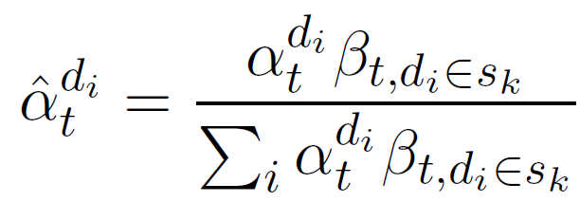
Method
Gated Selective Generator
Multi-hop inference computation :
Reweight word-level by Multi-hop :
Notes:
A1再圖4有
A1 = 3
A2 = 24

Slide 17
Method
Gated Selective Generator
Context representation:
Question :
Document :
Answer representation:
Question context
Decoder state
Document context
Notes:
A1再圖4有
A1 = 3
A2 = 24

Slide 18
Method
Gated Selective Generator
Output probability distribution :
Vocabulary :
Question :
Document :
Notes:
A1再圖4有
A1 = 3
A2 = 24

Slide 19
Method
Gated Selective Generator
Output :
Notes:
A1再圖4有
A1 = 3
A2 = 24

Slide 20
Method
Loss Function
Coverage loss :
Overall Loss Function:
$a_{t}^{ q_{j},d_{i}}$ = $e_{t}^{ q_{j},d_{i}}$ / $\sum_{i}{e_{t}^{q_{j},d_{i}}}$
Notes:
A1再圖4有
A1 = 3
A2 = 24

Slide 21
Outline
Introduction
Method
Experiment
Conclusion

Slide 22
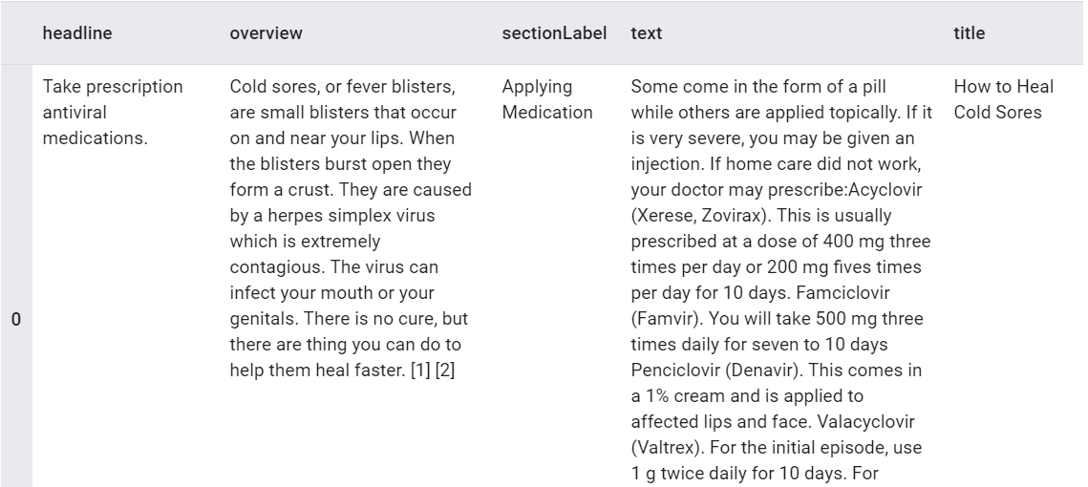
EXPERIMENT
22
Data set
WikiHow:
PubMedQA:
1000 expert.
61.2k unlabeled QA pairs.
211.3k man made QA pairs。
Notes:
CNN/DM:
NYC : 他的summary有時並不是句子，而且十分零碎，較不適合這項模型的設計。

Slide 23
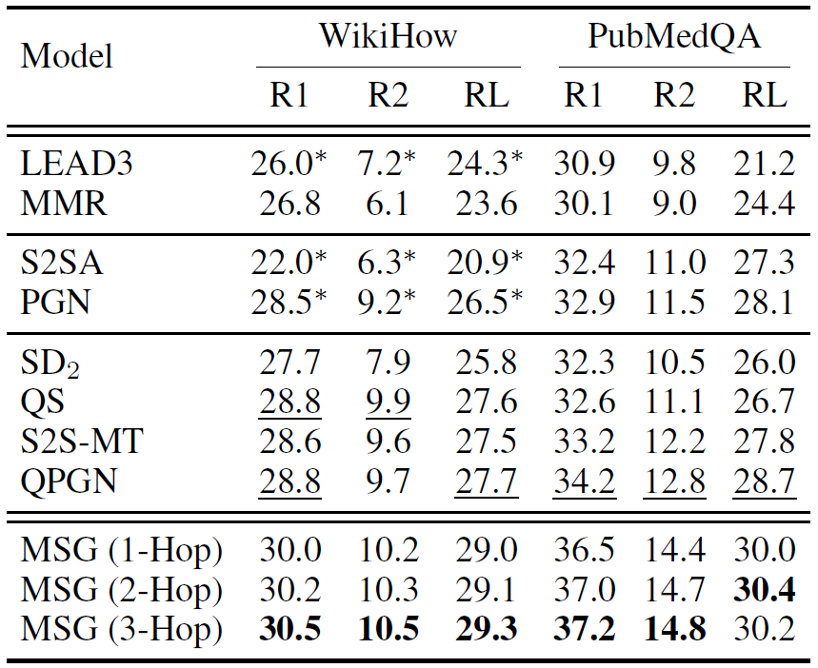
EXPERIMENT
23
Result
Notes:
紅 : extractive approach
黃 : abstractive approach
綠1 : Question +Document(co-attention) PGN
綠2 : Query base PGN
藍 1 : [Document ; Question] multi-task learning
ELI5:long form question answering.
藍 2 : Question +Document(co-attention) PGN
Joint learning of answer selection and answer summary generation in community question answering

Slide 24
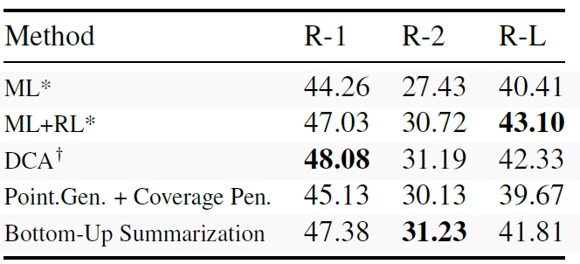
EXPERIMENT
24
Result on CNN/DM
Results on the NYT corpus, where we compare to RL trained models. * marks models and results by Paulus et al. (2017), and results by Celikyilmaz et al. (2018).
Notes:
作者認為可能是參數選擇導致其結果不比其他人好，但他無法確認。
而且這模型本來就不是針對於NYC的資料集設計，不向上述其他模型，但仍然十分有比較性。

Slide 25
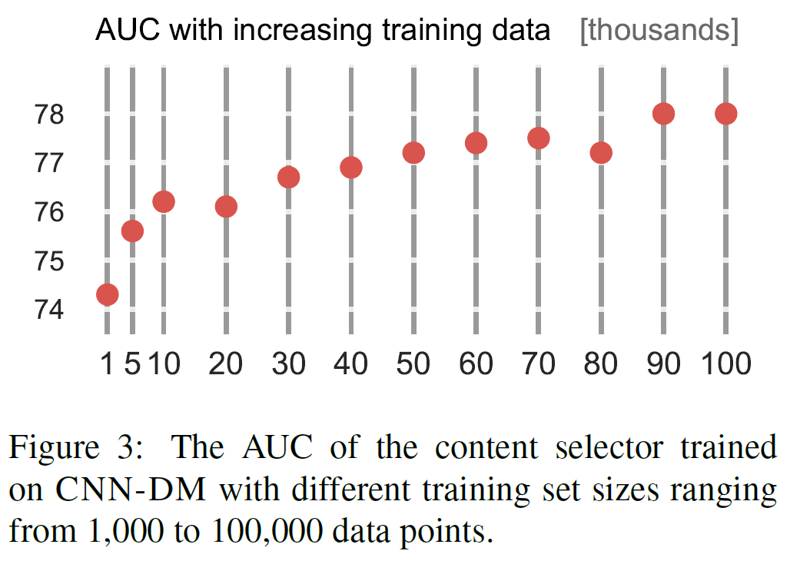
EXPERIMENT
25
content selector

Slide 26
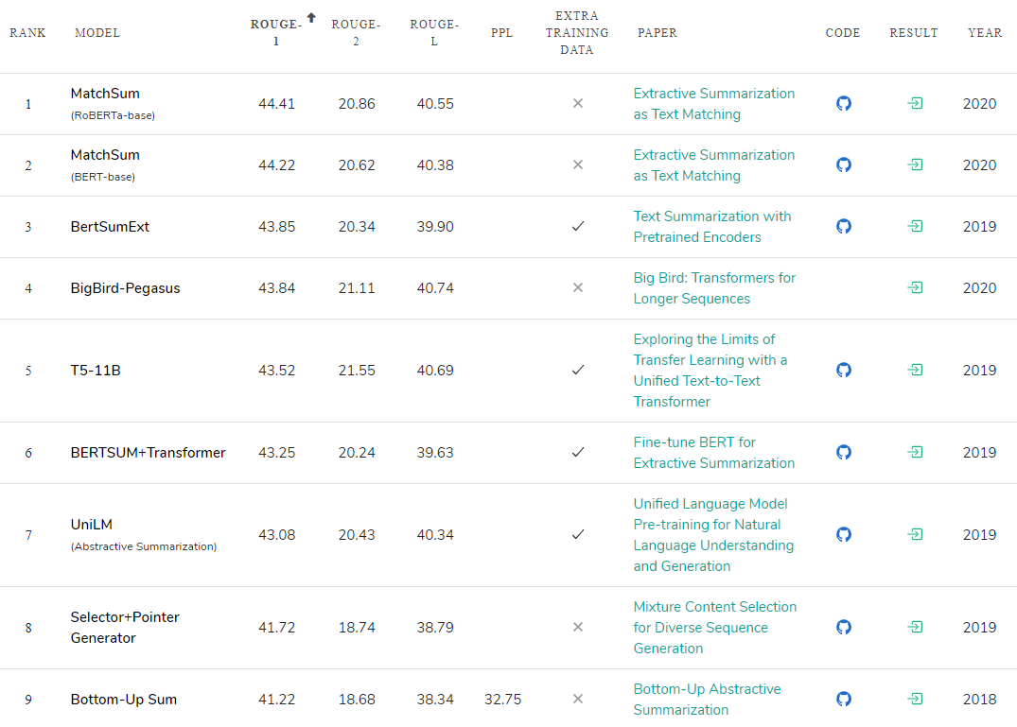
EXPERIMENT
Rank on CNN/DM data set

Slide 27
Conclusion
This work presents a simple but accurate content selection model for summarization that identifies phrases within a document that are likely included in its summary.
We showed that this content selector can be used for a bottom-up attention that restricts the ability of abstractive summarizers to copy words from the source.
Preliminary work that investigates similar bottom-up approaches in other domains that require a content selection, such as grammar correction, or data-to-text generation, have shown some promise and will be investigated in future work.

